Slide 1




Why People in the Western US Are Dissatisfied with their Health Insurance
Peter D.R. Higgins, Megan McLeod, and Jeffrey Berinstein
University of Michigan
@ibddoctor
Slide deck: https://speakerdeck.com/higgi13425

Slide 2

Teaching
I teach MDs how to analyze clincal data in R (tidy-biased)
Start with toy medical datasets
Move to real medical data as soon as possible
Learn with datasets that learners care about
Build in reproducible research practices early

Slide 3
Why Bother to Teach MDs?
John Snow, MD
Developed early version of geom_sf
Removed pump handle
Tommy Francis, MD
Enrolled 1.8 million children
Analyzed results with punch cards
Mona Hanna-Atisha, MD, MPH
Wrangled data from EMR
Compared lead levels

Slide 4

Learning R Can Lead to New Insights
I wanted to
Learn rvest for harvesting data
Learn geom_sf for mapping
My patients are frequently unhappy with their health insurance
They have to select a health insurance plan each October
They have little information on which to base a selection
ON HOLD WITH
INSURANCE CO
FOR 3 HOURS, STILL NO ANSWER

Slide 5

Learning R with Real Data
Found the NCQA site: National Committee for Quality Assurance reports health insurance consumer satisfaction
Each private insurance plan rated on a 0-5 scale each year
Website http://healthinsuranceratings.ncqa.org/2018/
150 sub-websites, for 3 insurance types x 50 states, i.e. this link http://healthinsuranceratings.ncqa.org/2018/search/Commercial/AL
This link provides ratings for private(Commercial vs. Medicaid and Medicare) insurance plans in Alabama

Slide 6

Looping with rvest
link <- “http://healthinsuranceratings.ncqa.org/2018/”
for (i in 1:length(state_abbs))
{
for (j in 1:length(instype))
{
healthins <- read_html(paste0(link, "/", instype[j], "/", state_abbs[i]))
onetable<- as.data.frame(healthins %>% html_nodes("table") %>% .[[3]] %>% html_table(fill=T))
if (i=1 & j =1) {
fulltable <- onetable
} else {
fulltable <- bind_rows(fulltable, onetable)
Some cleaning of missing ratings, names of plans, etc. to get a clean dataframe
group_by() %>% summarize() to get the mean Commercial insurance plan satisfaction by state
Now map it

Slide 7

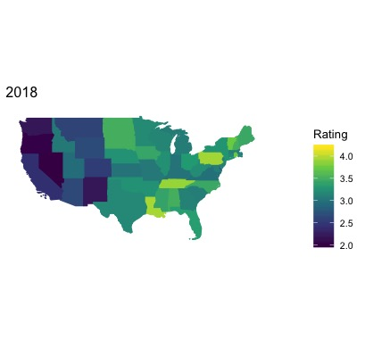
Mapping with geom_sf()
map_2018 <- consumersat_2018 %>%
ggplot(aes(fill = consumer_satisfaction_rating, color=consumer_satisfaction_rating)) +
geom_sf() +
scale_fill_viridis_c() + #fill scale
theme_minimal(base_size = 10) + #base font size
coord_sf(xlim = c(-60, -125), ylim = c(20, 50),
datum = NA) + #sets limits, turns off lat/long grid
labs(title = "2018", fill = 'Rating')

Slide 8
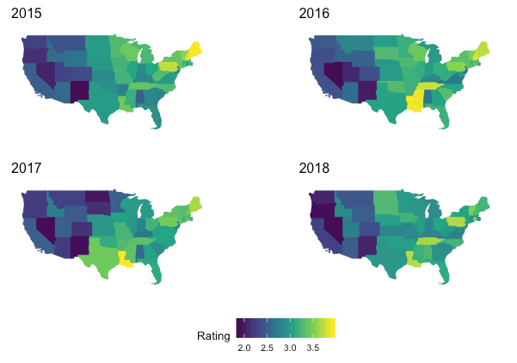
Multiple Years of Insurance Satisfaction
pubmap1 <- ggpubr::
ggarrange(map_2015,
map_2016, map_2017,
map_2018, ncol=2, nrow=2,
common.legend = TRUE,
legend="bottom")
pubmap1
That is surprising.
And surprisingly consistent
over time.
Why are Westerners dissatisfied with Commercial health insurance?

Slide 9
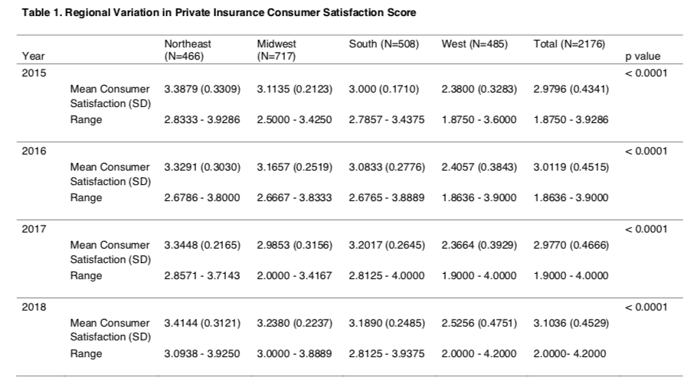
Is This a Regional Effect?

Slide 10
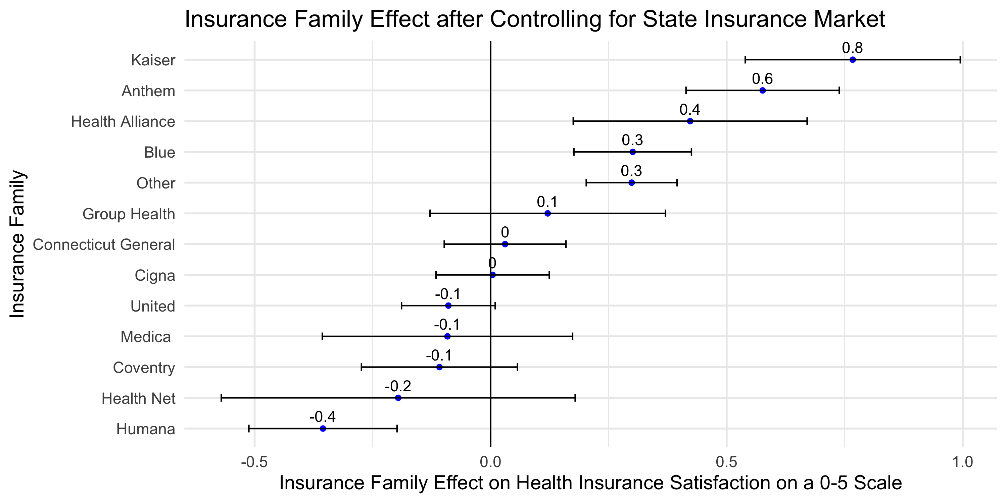
Insurance Family Performance

Slide 11
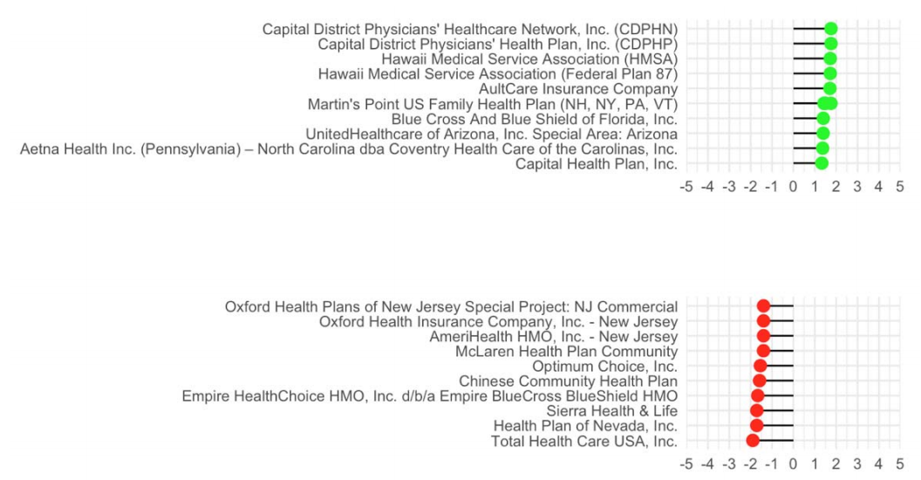
Outlier Health Insurance Plans
After controlling for state and insurance family
Top Ten Over-performers
Bottom Ten Under-performers

Slide 12
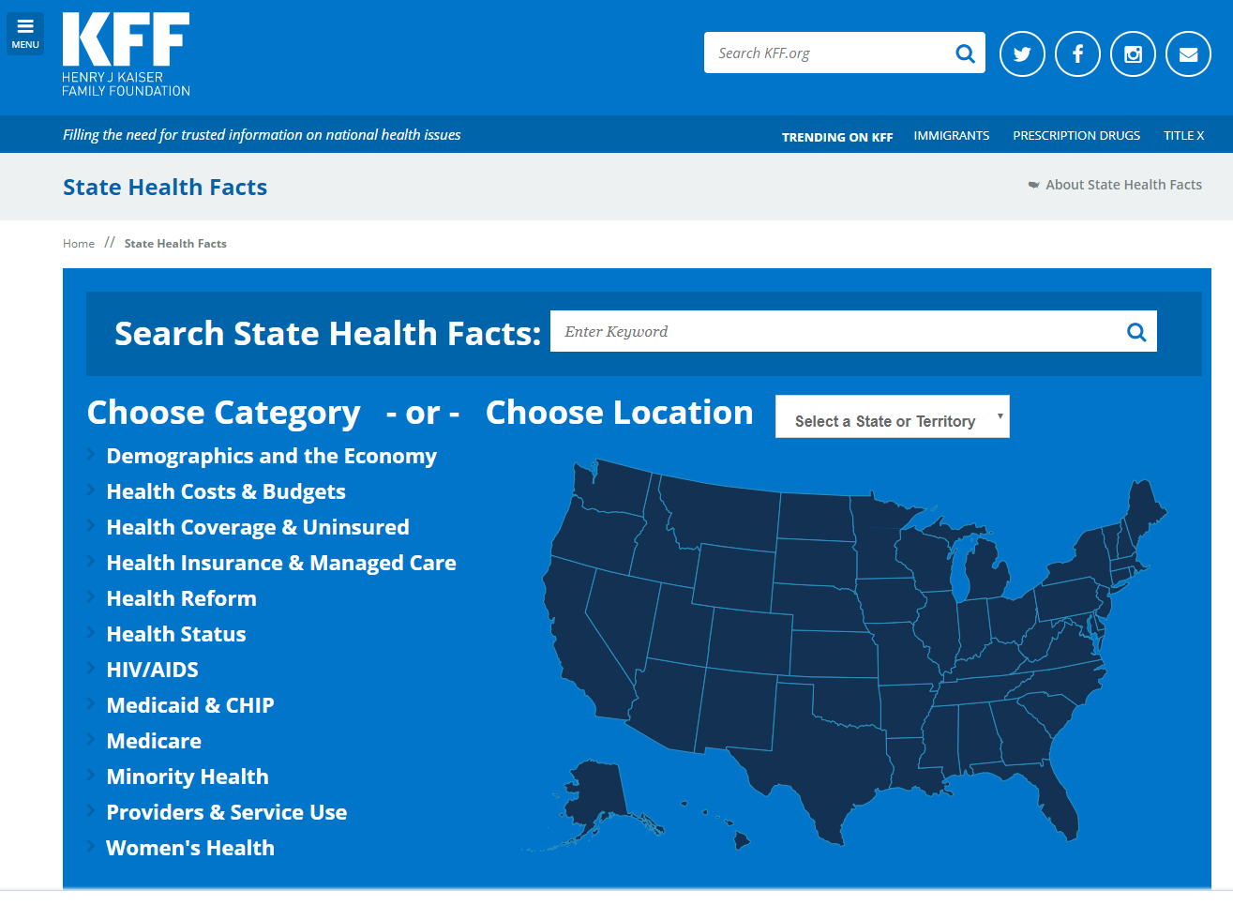
So Why Are Westerners Dissatisfied?
State level explanatory variables needed
State Health Facts website https://www.kff.org/statedata/
All downloadable

Slide 13
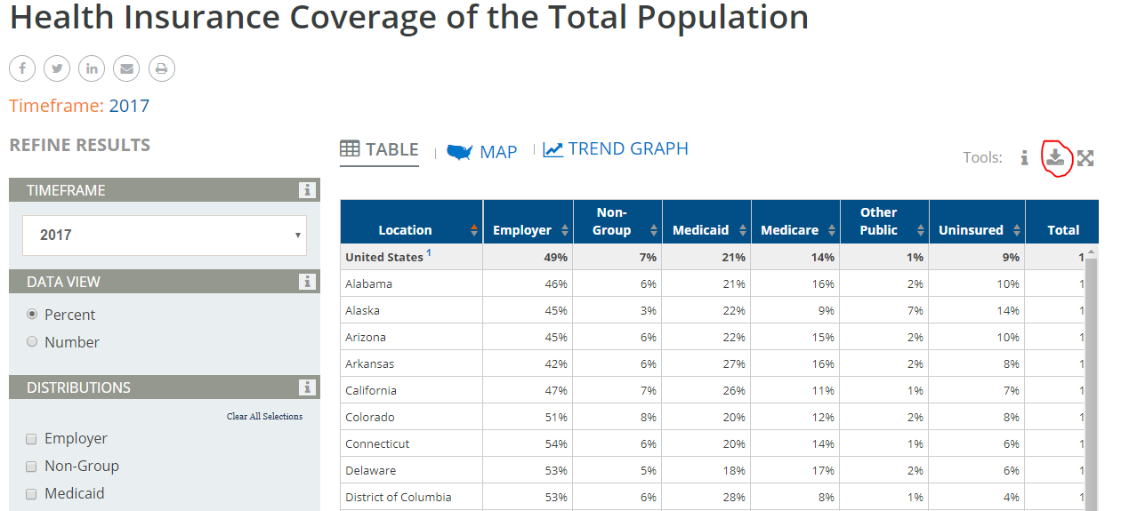
Why Are Westerners Dissatisfied?
Download
.csv datafiles
here

Slide 14
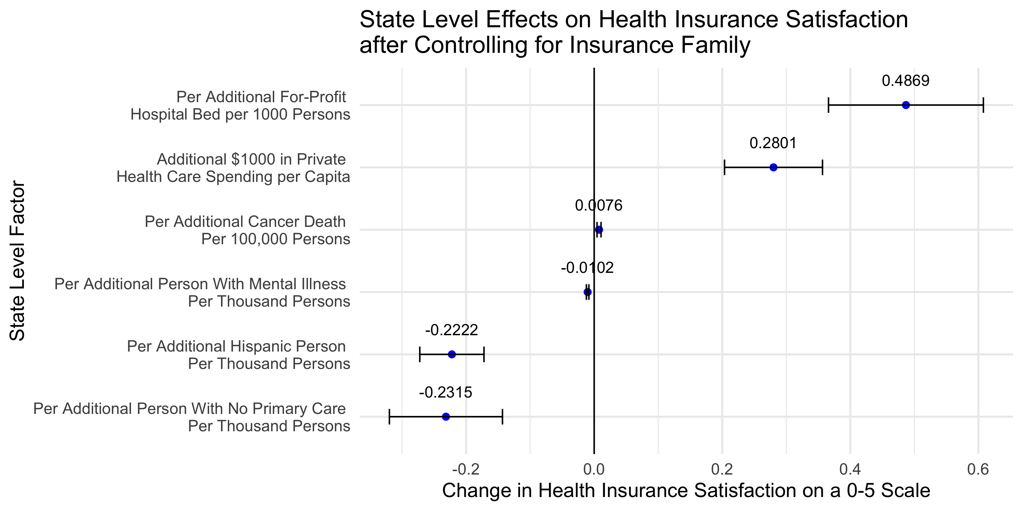
State-level Factors Model

Slide 15
Take Home Points
Learn new skills with new packages in R
Practice with real data that are important to you
You might learn something new and useful

Slide 16
Data, Code, and Preprint Manuscript
Github
OSF: Open Science Foundation repository
https://osf.io/xcbe4/
Preprint: MedRxiv https://www.medrxiv.org/content/10.1101/19004762v2

Slide 17
Thank You
@ibddoctor
Slide deck: https://speakerdeck.com/higgi13425

